Slide 1
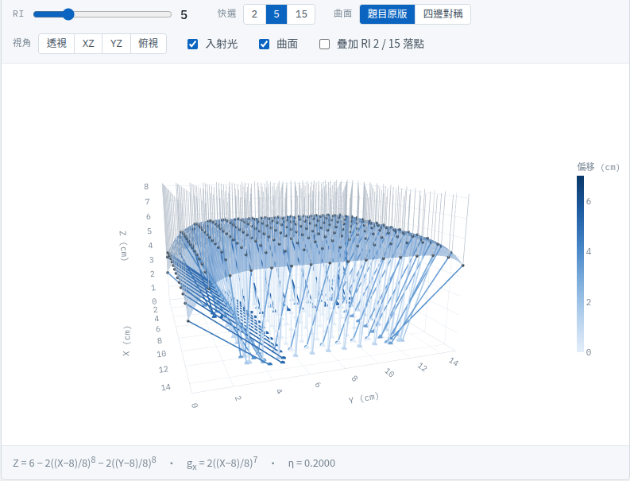
Exercise Project 1 (DCIC)
Chiahung Carlos Ma
Ph.D. student, RF&MW lab, NSYSU
chiahungma@akiragather.com.tw
carlos@akiragather.com.tw
D143010009@g-mail.nsysu.edu.tw
11/3/2026 UTC+8

Slide 2
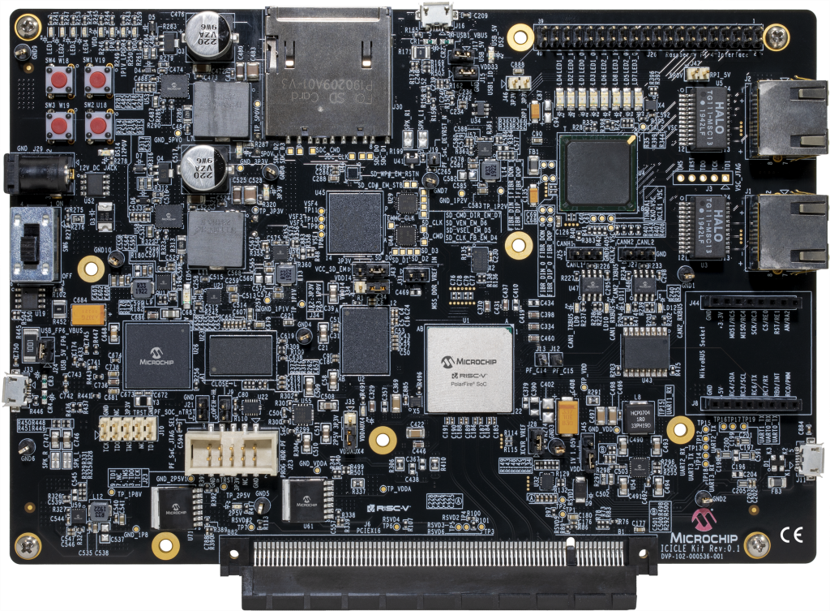
Agenda
01
Architecture of algorithm
02
Architecture of modules for implementation
03
Summary of simulation
04
appendix
05
06

Slide 3
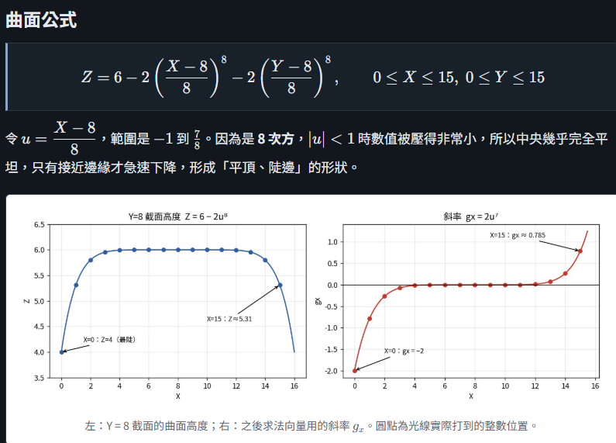

Architecture of algorithm

Slide 4
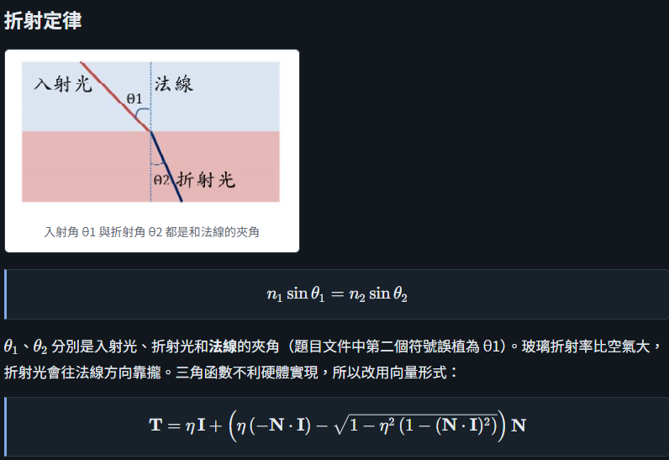
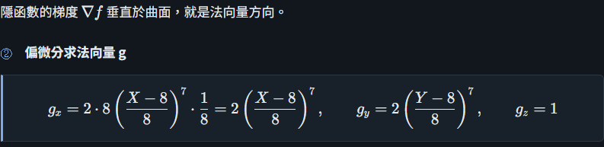

Architecture of algorithm

Slide 5
Architecture of ray_top
ray_top
SRAM transmit block
FSM control module
z_surface
SRAM
test
ray_z0

Slide 6
Architecture of z_surface (combinational circuit to get the z value on surface for 256 points)
// ==========================================================================
// z_surface.v
// ==========================================================================
//Z=6−2((x-8)/8)^8-2((y-8)/8)^8
module z_surface (
input wire [3:0] x, //q4
input wire [3:0] y, //q4
output reg [27:0] z //q4.24
);
reg signed [39:0] temp, dx, dy;
always @(*) begin
// ** with a non-constant base can't be synthesized, so multiply out (x-8)^8
dx = {36'b0,x} - 40'sd8;
dy = {36'b0,y} - 40'sd8;
temp = (40'sd6 << 24)-((dx**8)<<1) - ((dy**8)<<1);
z=temp[27:0];
end
endmodule

Slide 7
Architecture of test (sequential circuit)
test
root=length of normal vector
[xl_l,yl_l,zl_l] (normal vector to surface) for gen [num_x, num_y, num_z]
Use [num_x, num_y, num_z] and value of root to gen [qx, qy, qz]
[qx, qy, qz]=unit normal vector
normal_vector(combination)
start/assign [xl_l,yl_l,zl_l]
refract_vector
Assign [qx,qy,qz]
sqrt_seq
sqrt_done/assign root value
done
Array of div_seq for 3 values
Get sign of [xl_l,yl_l,zl_l]

Slide 8
Architecture of test (sequential circuit)
refract_vector
To get the unit refracted vector
done0(input)
&&done1
Get ^0.5 of input value
//N*I
//1-(N*I)^2
//n^2*(1-(N*I)^2)
//1-n^2*(1-(N*I)^2)
//T=n*I+(n*(-N*I)-coef*N
//coef=(1-n^2*(1-(N*I)^2))^0.5)

Slide 9
Architecture of ray_zo
ray_z0
(start && (!busy || div_done))
To get the ( x, y, 0) values from the ray line formula with unit refract vector
Use to div modules to get (x,y,0)
div_done
Fsm controller
Scale to Q4,12 of (x,y,0) for 256 points
end

Slide 10
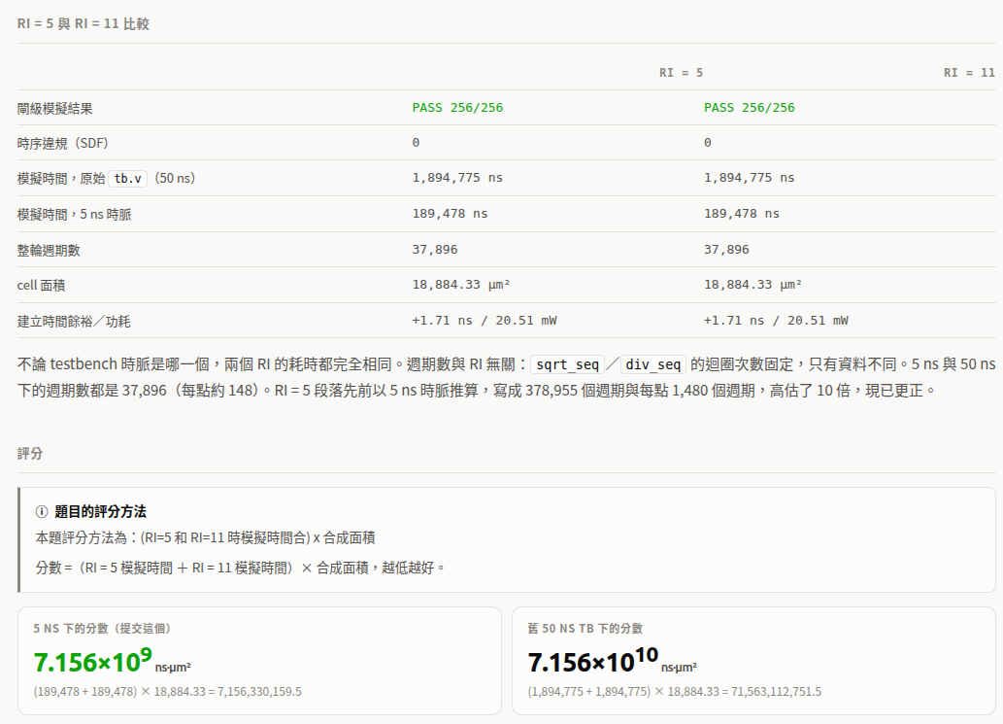
Summary of simulation

Slide 11
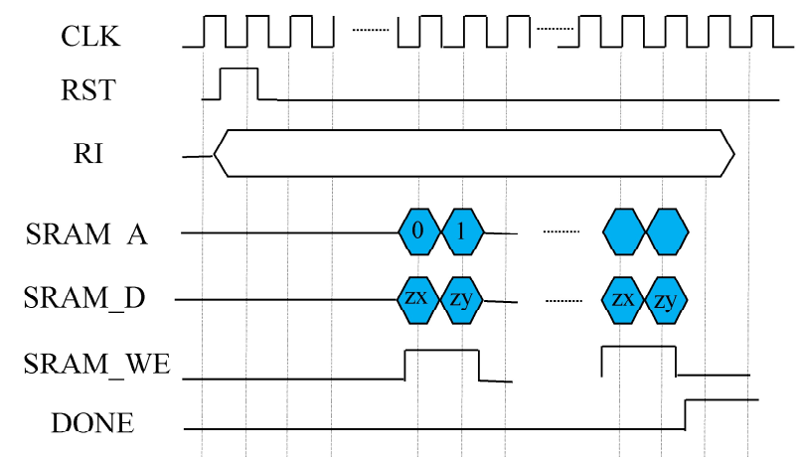
appendix
Add another highlight from this quarter. For example, this could be a successful project. Use this slide to describe the project goals, challenges, and outcomes.

Slide 12
Thank you~

Slide 13
Appendix source code of refract_vector
// ==========================================================================
// refract_vector.v
// ==========================================================================
//T=n*I+(n*(-N*I)-(1-n^2*(1-(N*I)^2))^0.5)*N
//I is unit input vector, N is unit normal vector
//n is refractive index ratio 1/1,1/2~1/16
//T is unit output vector
module refract_vector(
input wire CLOCK2_50, input wire done0, input wire signed[1:0] Ix, //q2 input wire signed[1:0] Iy, //q2 input wire signed[1:0] Iz, //q2 input wire signed[35:0] Nx, //q2.34 input wire signed[35:0] Ny, //q2.34 input wire signed[35:0] Nz, //q2.34 input wire [16:0] n, //q1.16 input wire reset, //active low output wire signed [91:0] Tx, //q8.84 output wire signed [91:0] Ty, //q8.84 output wire signed [91:0] Tz, //q8.84 output wire done //one clock, Tx, Ty, Tz valid from this clock on);
// done0 pulses on the edge that updates N, so the sqrt starts one clock
// later, from the new N; T is latched when it is done (W/2 = 28 clocks)
reg sqrt_start, done_r;
wire [27:0] sqrt_one_m_n_sq_times_one_m_NI_sq; //q3.25
wire done1; //sqrt done

Slide 14
Appendix source code of refract_vector
always @(posedge CLOCK2_50 or negedge reset) begin
if (!reset) begin
sqrt_start <= 1'b0; done_r <= 1'b0;
end else begin
sqrt_start <= done0; done_r <= done1;
end
end
reg signed [37:0] NI; //q4.34
reg signed [41:0] one_m_NI_sq; //q8.34
reg signed [55:0] one_m_n_sq_times_one_m_NI_sq; //q6.50
reg signed [55:0] n_sq_times_one_m_NI_sq; //q6.50

Slide 15
Appendix source code of refract_vector
always@(*) begin
//N*I
NI = $signed(Nx)*$signed(Ix) + $signed(Ny)*$signed(Iy) + $signed(Nz)*$signed(Iz); //q4.34
//1-(N*I)^2
one_m_NI_sq = (8'sd1<<34) - (($signed({{38{NI[37]}},NI})* NI)>>>34); //q8.34
//n^2*(1-(N*I)^2)
n_sq_times_one_m_NI_sq = ((($signed({1'b0,n})*$signed({1'b0,n}))) * $signed({{36{one_m_NI_sq[41]}},one_m_NI_sq})) >>> 16; //q2.32*q8.34=.66 -> q6.50
//1-n^2*(1-(N*I)^2)
one_m_n_sq_times_one_m_NI_sq = ((12'sd1<<50) - n_sq_times_one_m_NI_sq); //q6.50
end

Slide 16
Appendix source code of refract_vector
//sqrt(1-n^2*(1-(N*I)^2))
sqrt_seq #(.W(56)) sqrt_seq_inst (
.clk (CLOCK2_50),
.rst (reset),
.start (sqrt_start),
.radicand(one_m_n_sq_times_one_m_NI_sq), //q6.50
.root (sqrt_one_m_n_sq_times_one_m_NI_sq), //q3.25
.done (done1)
);
// vectors as arrays: index 0 = x, 1 = y, 2 = z
wire signed [1:0] I [0:2]; //q2
wire signed [35:0] N [0:2]; //q2.34
reg signed [91:0] T [0:2]; //q2.34
assign I[0] = Ix; assign I[1] = Iy; assign I[2] = Iz;
assign N[0] = Nx; assign N[1] = Ny; assign N[2] = Nz;

Slide 17
Appendix source code of refract_vector
// wire signed [27:0] sqrt_one_m_n_sq_times_one_m_NI_sq; //q3.25
// reg signed [37:0] NI; //q4.34
//T=n*I+(n*(-N*I)-(1-n^2*(1-(N*I)^2))^0.5)*N
// T = n*I + (n*(-N*I)-sqrt_one_m_n_sq_times_one_m_NI_sq)*N
reg signed [19:0] nI; //q4.16
reg signed [91:0] vN; //q8.84
reg signed [55:0] n_multiply_minusNI; //q6.50
integer k;
always @(posedge CLOCK2_50) begin
if (done1) begin // root is for the current N
for (k = 0; k < 3; k = k + 1) begin
nI = $signed({1'b0, n}) * I[k]; // q2.16 * q2 -> q4.16
n_multiply_minusNI = $signed({1'b0, n}) * (-NI); // q2.16 * q4.34 -> q6.50
// (q6.50-q3.25<<25) * q2.34 -> q8.84
vN = (n_multiply_minusNI - $signed({19'd0, sqrt_one_m_n_sq_times_one_m_NI_sq, 25'd0}))*N[k];
T[k] <= (nI <<< 68) + (vN); // q4.16<<68 -> q8.84
end
end
end
assign Tx = T[0]; assign Ty = T[1]; assign Tz = T[2];
assign done = done_r;
endmodule

Slide 18
appendix
https://www.akiragather.com.tw/textbook/digitalComunicationCircuitDesign/EP1_Summary.html#ri11

